Slide 1
Plan Overview
Gather sample wafermaps with signatures to classify
Inline Maps for Pele, Sail
WFT maps for SRAM Fail signatures
WFT sort maps
Determine format in which data will be fed into the function
Create classification initially using the K-Means method
Tweak algorithm and review results
Potential types of signatures:
Regional
Radius regions
Specific locations on wafer
Systematic – One location consistently fails
By Wafer Number
For all / many wafers in a lot
Tester issues
Half of wafer then goes away

Slide 2
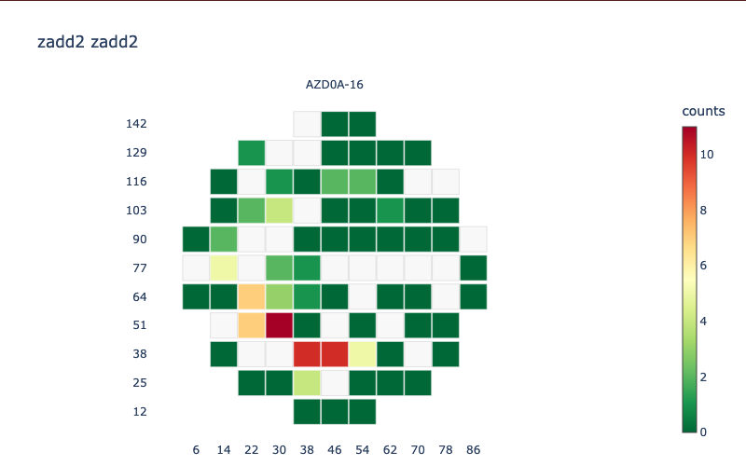
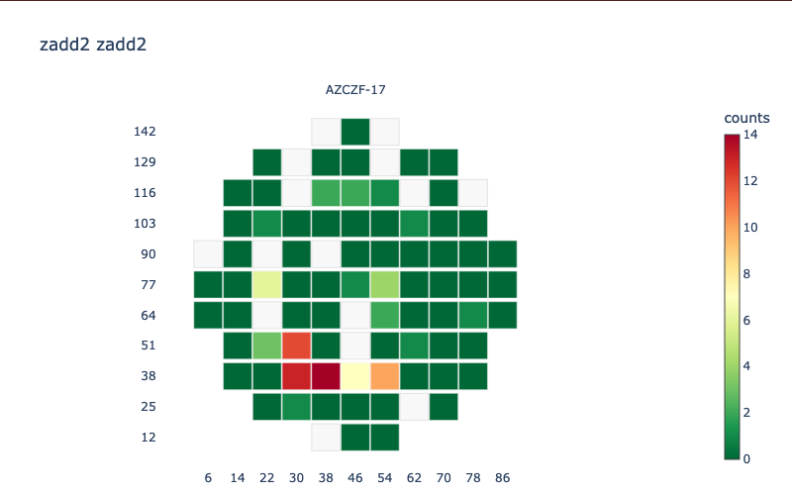
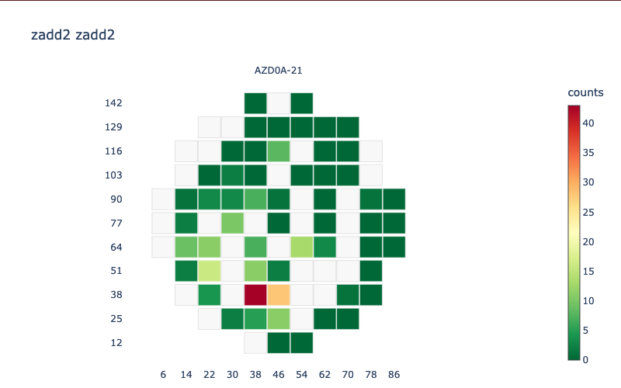
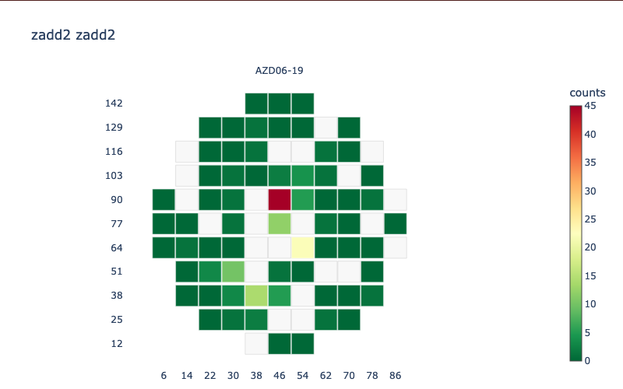
Shadow Cache Fails (zA_shdwcac_fails_wftcoord.csv)
Two good examples for classification are AZD0A-16 and AZCZF-17.
Harder to classify wafers examples are AZD0A-21 and AZD06-19.

Slide 3
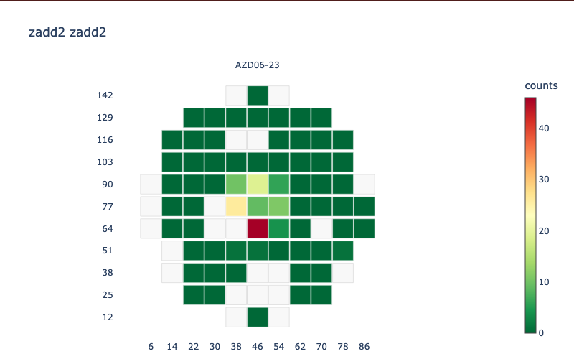
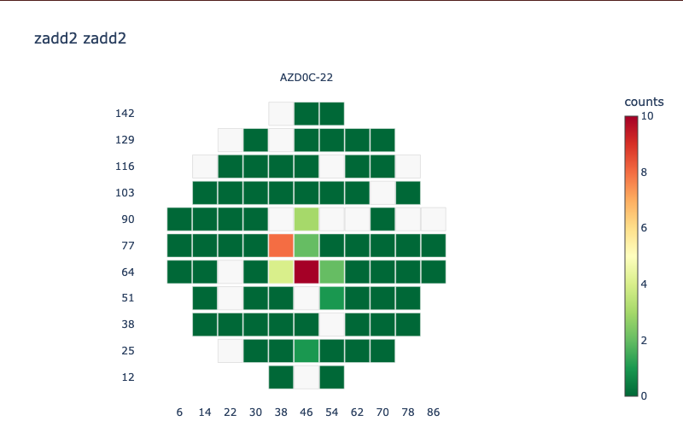
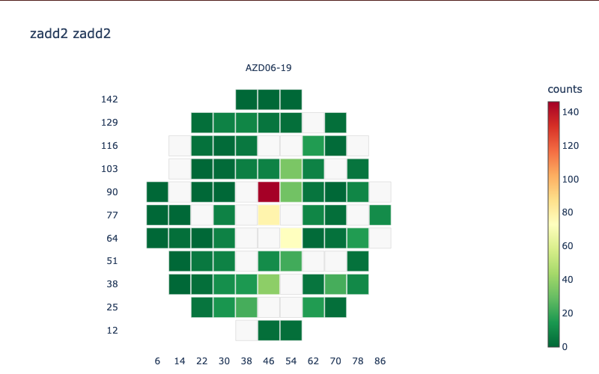
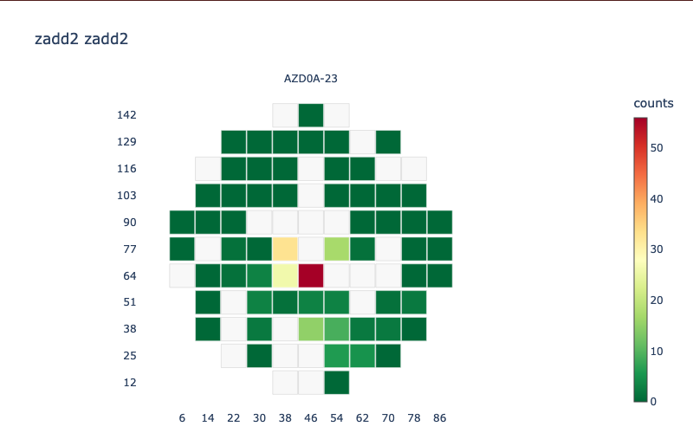
Shadow Cache Fails (zA_s6t_fails_wftcoord.csv)
Two good examples for classification are AZD06-23 and AZD0C-22.
Harder to classify wafers examples are AZD06-19 and AZD0A-23.

Slide 4
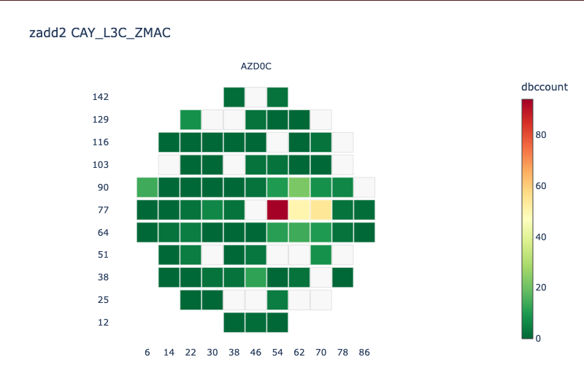
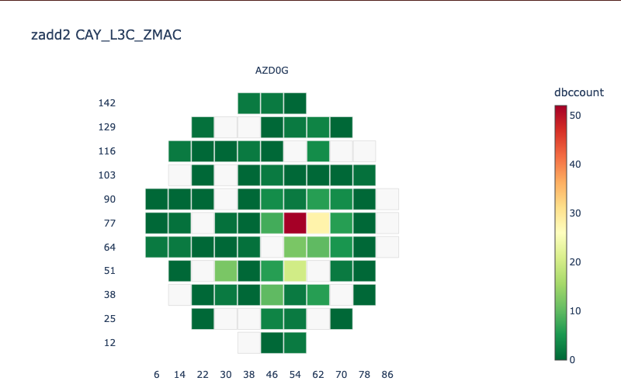
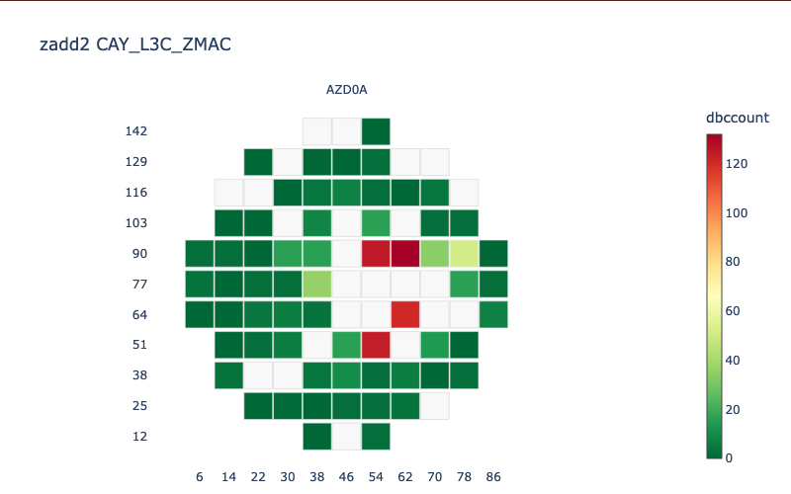
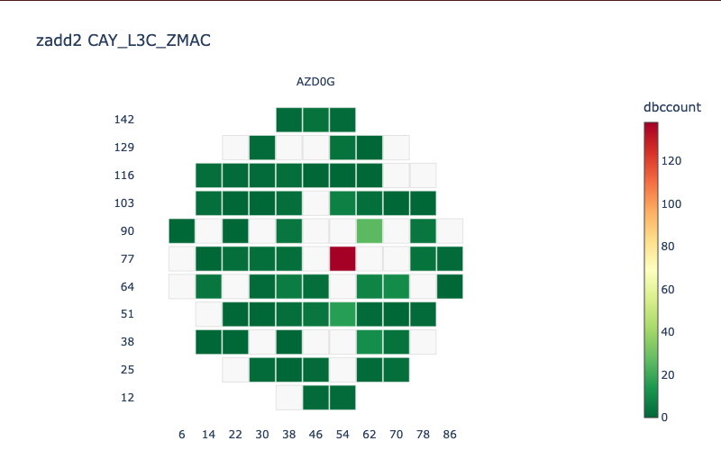
Shadow Cache Fails (p10_za_wft_sram_dbc_fails.csv)
Two good examples for classification are AZD0C-06 and AZD0G-12.
Harder to classify wafers examples are AZD0A-14 and AZD0G-18.

Slide 5
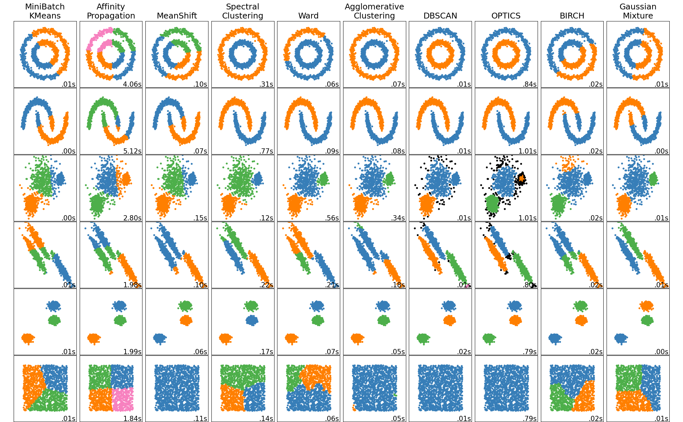
https://scikit-learn.org/stable/auto_examples/cluster/plot_cluster_comparison.html#sphx-glr-auto-examples-cluster-plot-cluster-comparison-py

Slide 6
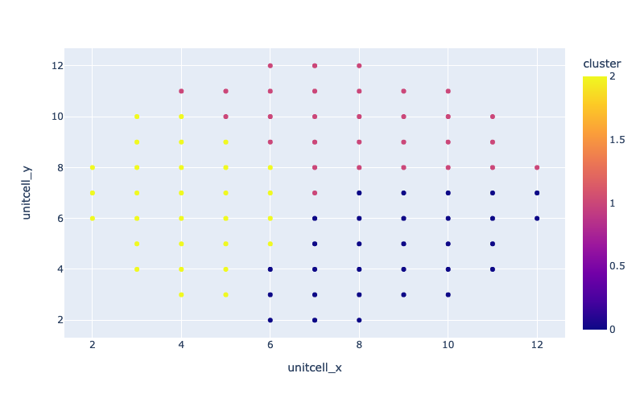
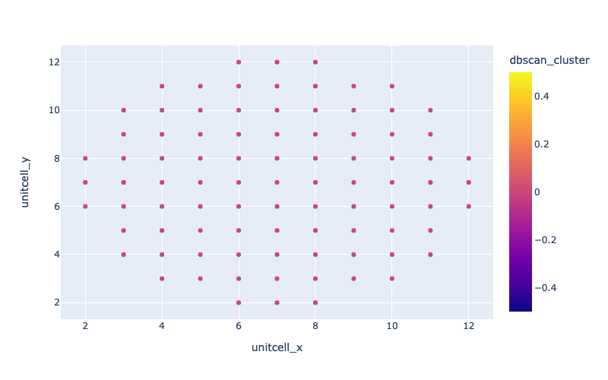
Current Attempts
KMeans
DBScan
KMeans most likely doesn’t do a great job of classifying hotspots within the wafer
DBScan seems difficult to classify evenly distanced points
Need to brainstorm how to weight individual points when classifying
Personal issue: trouble installing Tensorflow for M1 chip on new Mac

